Slide 1
Privacy-Preserving Collaborative IDS for Internet-of-Vehicle Networks
Thanking,
Dr. Durga
Dr. Uma
Dr. Anusuya
Dr. Praveen

Slide 2
Recap from Last Meeting
ChebyKAN adopted as the IDS trunk — 44,164 parameters, 14× smaller than the MamKANformer trunk
Layer-wise homomorphic federated aggregation demonstrated across all four datasets
Committed to CKKS (FheFL) so the server never sees an individual plaintext update
Review action item: present the mathematical foundations of CKKS — addressed in this deck

Slide 3
Contents
Mathematical foundations of CKKS
Baseline: FHE vs No-FHE — the control established before model quantization
System validation — proactive data-engineering validation
V2X communication protocol — FHE with AES / ECDH
Multi-key CKKS

Slide 4
Where We Stand
Threat model, security specification, library evaluation, packing & encoding module, NTT reference implementation
Automated tests guarding data integrity, cryptographic correctness, and the privacy invariant — all passing
Real CKKS now replaces the placeholder throughout the federated loop
The homomorphic aggregator is implemented now

Slide 5
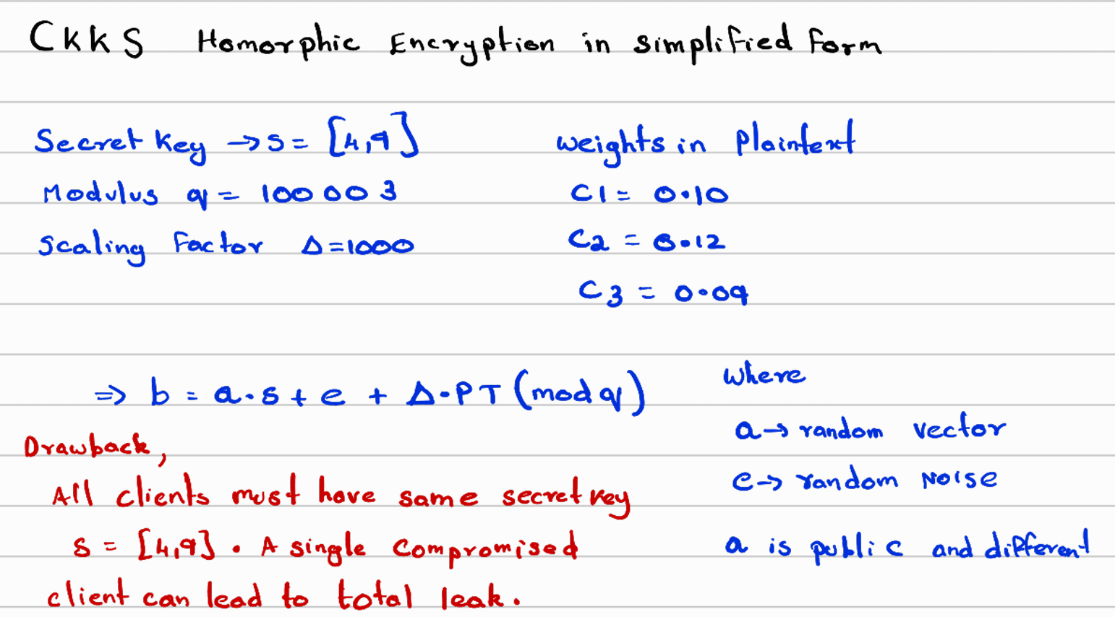
Mathematical Foundations — The CKKS Scheme (worked example)

Slide 6
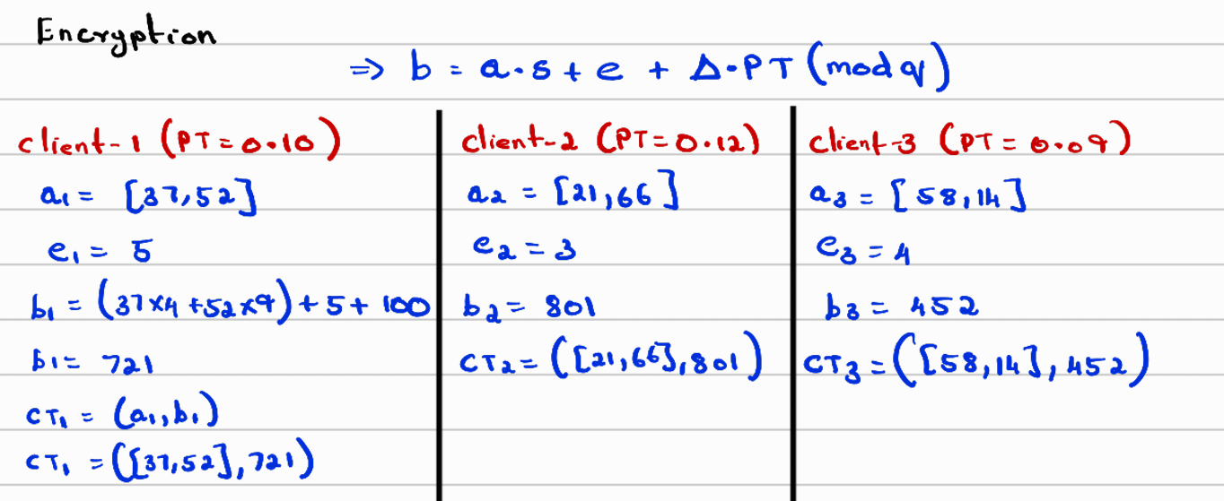
Mathematical Foundations — Homomorphic Aggregation (worked example)

Slide 7
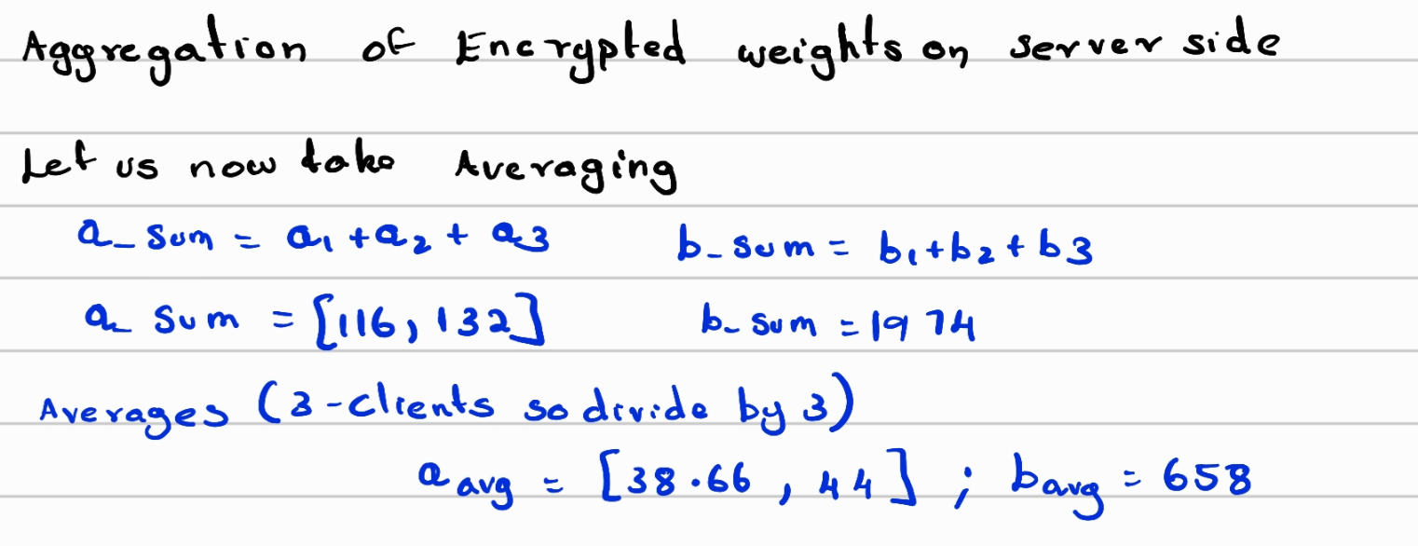
Mathematical Foundations — Homomorphic Aggregation (worked example)

Slide 8
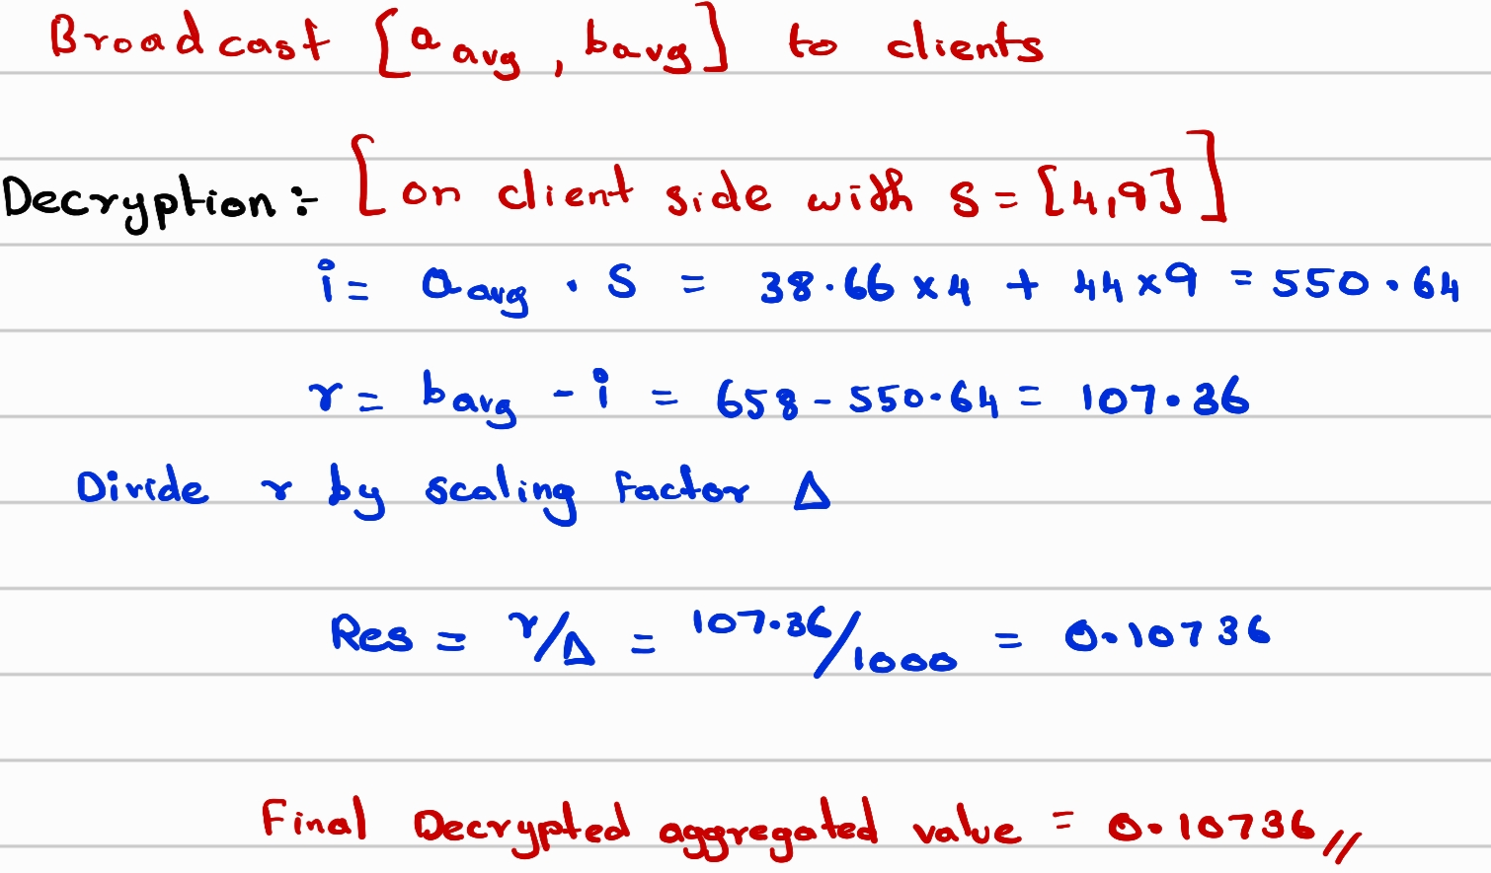
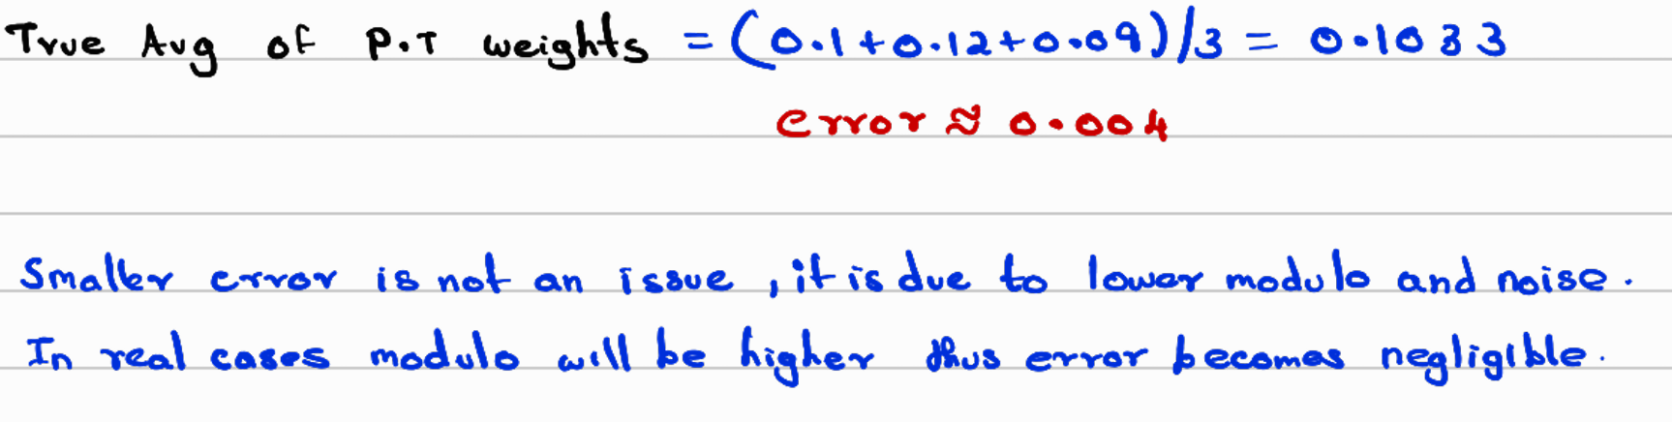
Mathematical Foundations — Homomorphic Aggregation (worked example)

Slide 9
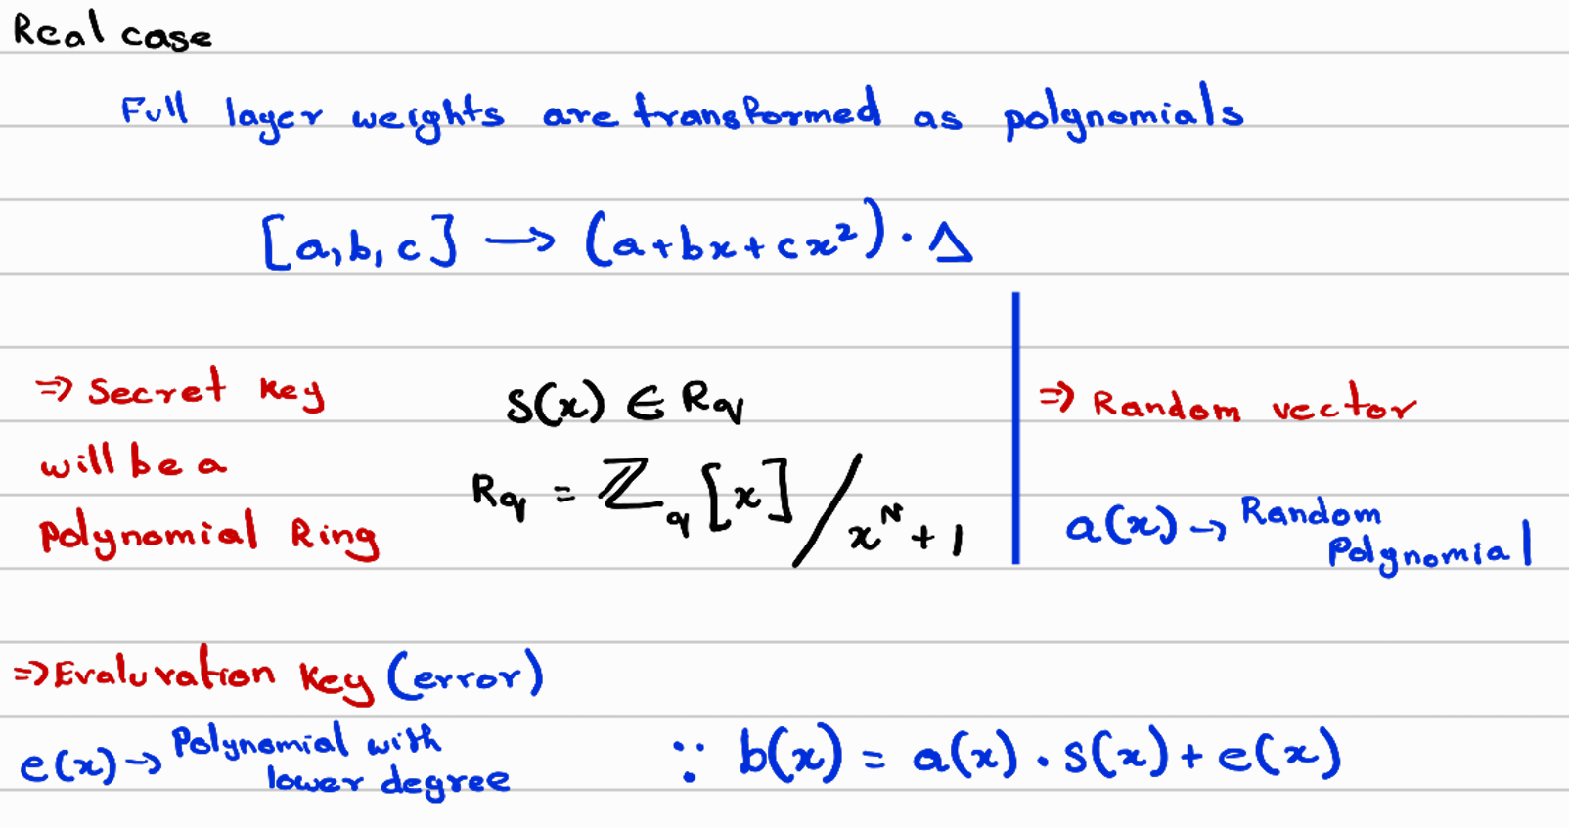
Mathematical Foundations — Homomorphic Aggregation (Real CKKS case)

Slide 10
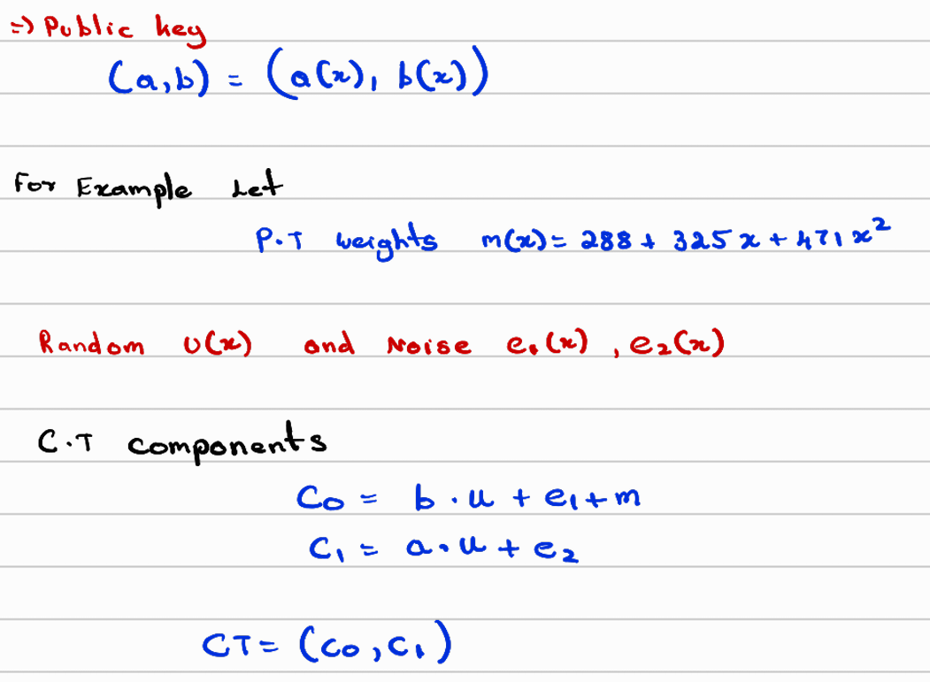
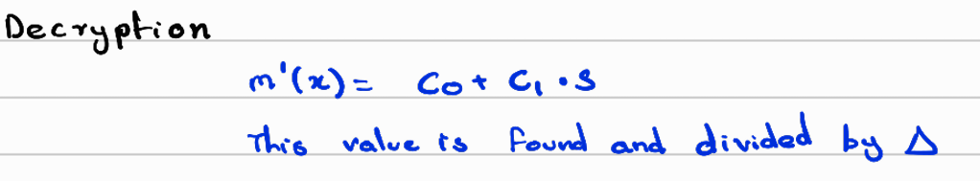
Mathematical Foundations — Homomorphic Aggregation (Real CKKS Case)

Slide 11
Mathematical Foundations — Noise, Depth, and Why It Shapes the Design
Every ciphertext carries growing noise; every ciphertext × ciphertext multiply consumes one prime ("level") from the modulus chain via rescaling
A chain of L primes supports L − 2 multiplications — the depth budget is the binding design constraint
Security is set by ring dimension N vs total modulus bits: at N = 8192, 128-bit security allows ≤ 218 bits → 2 multiplicative levels
Homomorphic addition is about 490× cheaper than ciphertext multiplication (measured)
Consequence: the FheFL protocol is engineered to need as few ciphertext × ciphertext multiplies as possible

Slide 12
Baseline: FHE vs No-FHE — Setup
Purpose: the mandatory control before model quantization — measure what encryption costs before adding a second approximation
Real TenSEAL CKKS on one arm, exact plaintext on the other, everything else held identical
3 seeds · 10 simulated vehicles · 5 federated rounds · Dirichlet α = 0.3 · 70% client sampling
The two backends are asserted bitwise-identical on the aggregation path (test_backend_equivalence)

Slide 13
Baseline: FHE vs No-FHE — Results
Dataset | CKKS acc | Plaintext acc | Δ | Verdict
CAN-VTC | 1.0000 | 1.0000 | +0.0000 | within seed noise
Car-Hacking | 0.9977 | 0.9981 | −0.0004 | within seed noise
CICIDS-2017 | 0.9555 | 0.9542 | +0.0012 | within seed noise
VeReMi | 0.4839 | 0.4851 | −0.0012 | within seed noise
Finding: encryption costs no accuracy — the CKKS/plaintext gap is smaller than seed-to-seed variance on every dataset
CAN-VTC = 100% is flood detection, not generalisation: the DoS attack floods one novel CAN ID (51% of traffic), separable by a single feature at 13σ. Split verified clean — the task is simply easy, not the earlier filename-label defect.
Car-Hacking is the CAN benchmark we stand behind: 5 real classes, best single feature only 0.94, injection density 12–24%
VeReMi is a near-chance lower bound: the cleaned export dropped sender IDs, so the misbehaviour signal cannot be expressed — re-acquisition required

Slide 14
What This Baseline Establishes
Real CKKS now replaces the previous placeholder (SimulatedCKKSVector), so the FHE-vs-plaintext comparison is a controlled experiment for the first time
Accuracy is encryption-invariant → any accuracy change under INT8 quantization is therefore attributable to quantization alone, not to encryption
Measured cryptographic cost per client update (44,164 parameters): encrypt ~42 ms · encrypted distance ~118–230 ms · homomorphic aggregation ~5–52 ms · ciphertext on the wire 2.47 MB

Slide 15
System Validation — Proactive Data-Engineering Validation
Before building the multi-key layer, we ran a full validation pass over the existing pipeline: check the foundation before adding a floor
Seven issues identified and all fixed, each now covered by a regression test:
  Ground-truth labels now per-message (HCRL R/T flag), not per-file
  Train/test split now group-aware by contiguous block — no window leakage
  FHE vs No-FHE now a controlled comparison (real CKKS, bitwise-checked)
  Server no longer decrypts individual client updates — FheFL scoring replaces Multi-Krum
  Transport security (AES / ECDH) restored
  VeReMi formulation diagnosed (needs sender IDs); documentation drift corrected

Slide 16
System Validation — Effect on Results and the Privacy Invariant
Headline accuracy figures were revised on the corrected pipeline: Car-Hacking 0.74 → 0.998 (fixed labels made the task well-posed); CICIDS 0.982 → 0.955 (leakage removed); CAN-VTC and VeReMi not comparable across formulations
These movements are the experiment starting to measure the right thing
Privacy invariant, machine-checked every round: individual client updates decrypted = 0 on all four datasets across 5 rounds each; only the aggregate is decrypted

Slide 17
V2X Communication Protocol — FHE with AES / ECDH
Two complementary layers, not alternatives:
  FHE → payload confidentiality from the aggregation server
  AES-256-GCM / ECDH-P256 / Ed25519 → authentication, integrity, replay resistance, Sybil resistance on the radio link
FHE provides none of the second list; removing the channel in last time traded a working control for a slogan
Status: the transport channel is restored and integrated; mutual-auth handshake tested (test_secure_channel)

Slide 18
V2X — The Bandwidth Problem
One 44k-parameter update = 2.47 MB encrypted (~915 DSRC frames); a 50-vehicle round ≈ 180 MB — does not fit a V2X budget
Delivered: Optimized Packing & Encoding module — 29.6% lossless reduction via level-dropped transmission, verified at zero accuracy cost
Further levers: seed compression (~50%, needs OpenFHE) · sparsification (needs an accuracy study) · hierarchical RSU pre-aggregation
Hierarchical aggregation is likely mandatory — an architecture decision to take early

Slide 19
Why Multi-Key CKKS
Federated Learning keeps raw data on IoV devices, but individual model updates can still reveal private information.
Homomorphic Encryption (HE) allows the server to perform computations on encrypted model updates.
Single-key HE can create privacy risks because the same secret key may be shared/accessible across participants.
MK-CKKS gives each device its own secret key, improving key isolation.
However, the paper identifies a privacy leakage problem during individual decryption in MK-CKKS.
xMK-CKKS is proposed to protect individual model updates while still allowing secure aggregation.
Source: [2104.06824] Privacy-preserving Federated Learning based on Multi-key Homomorphic Encryption

Slide 20
How xMK-CKKS Works
Each device generates its own secret key S_{i} and corresponding public key P_{i}
The public keys are combined into an aggregated public key: P̃ = P₁ + P₂ + ⋯ + P_{N}
Devices perform local training and encrypt their model updates under the aggregated public key P̃ — not under their own P_{i}
The server performs homomorphic addition on the ciphertexts without seeing individual model updates.
The server obtains an encrypted aggregate and returns the aggregated ciphertext component to the devices.
Each device uses its secret key S_{i} and the aggregated ciphertext to generate a decryption share D_{i}, then sends it to the server

Slide 21
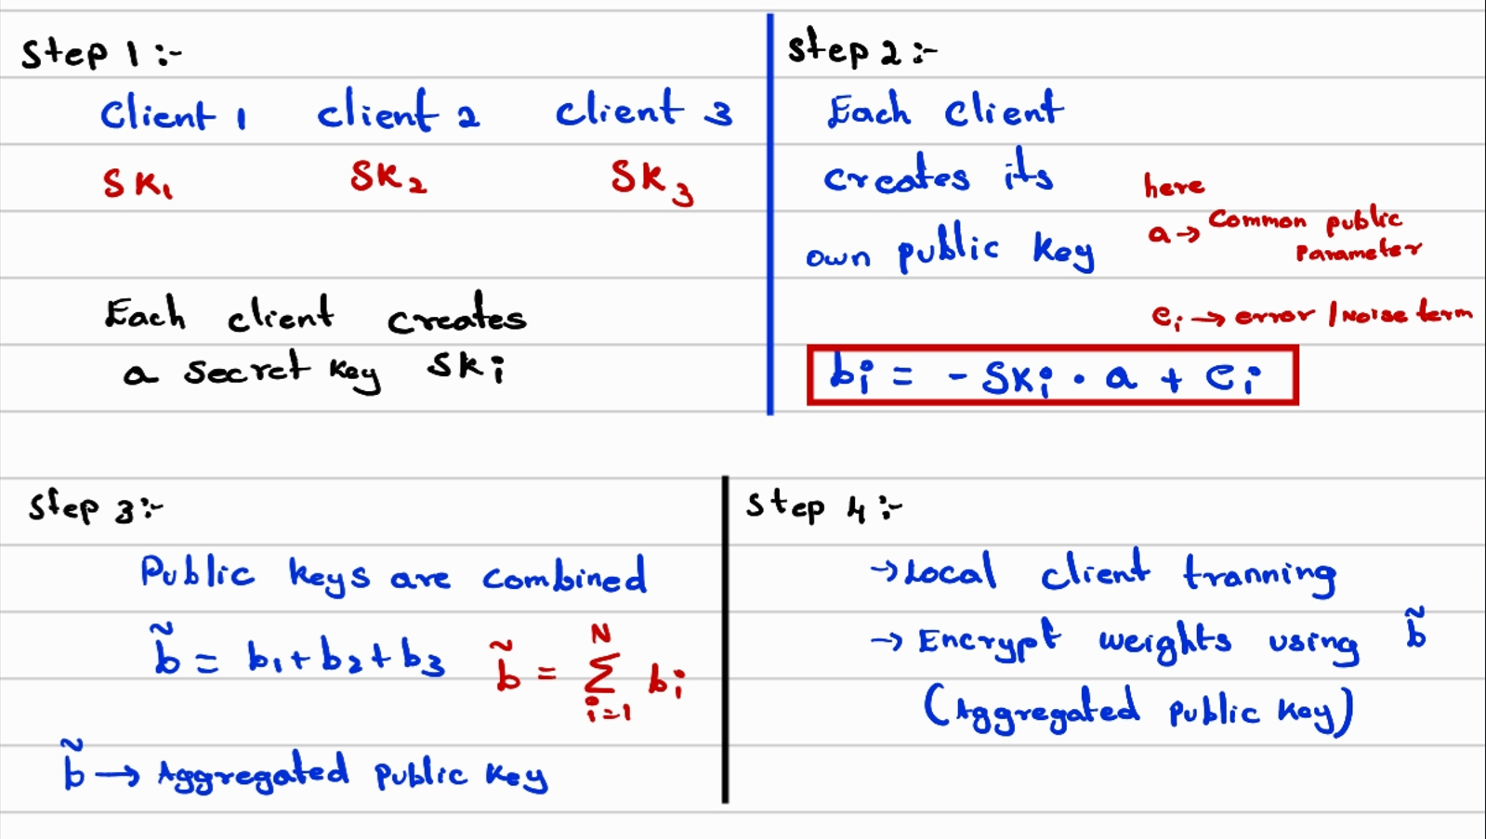
How xMK-CKKS Works

Slide 22
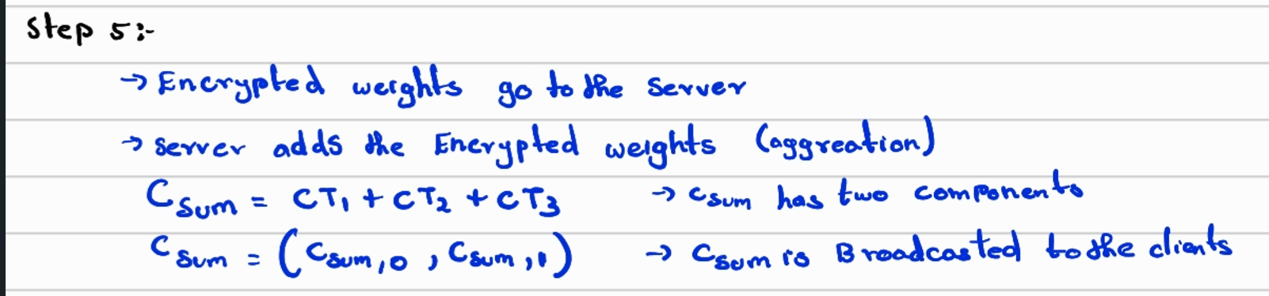
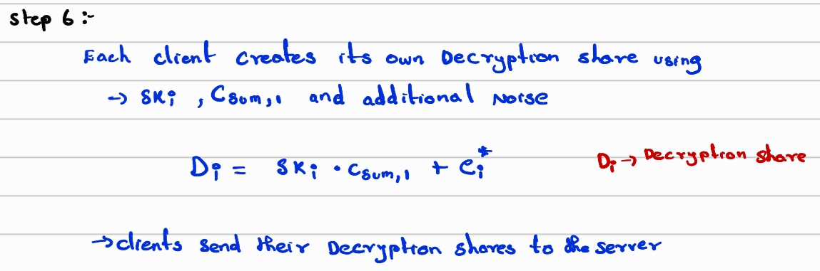
How xMK-CKKS Works

Slide 23
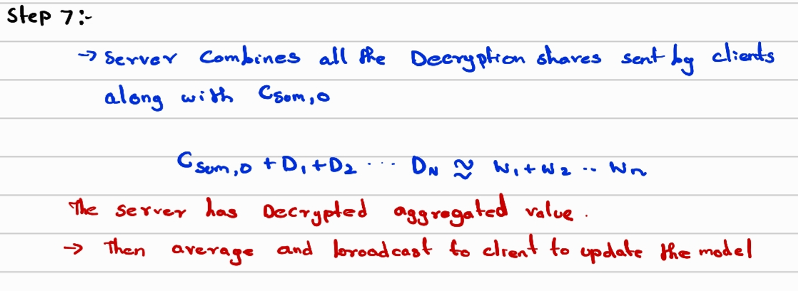
How xMK-CKKS Works

Slide 24
Secure Aggregation & Benefits
The server combines the decryption shares with the aggregated ciphertext to recover only the sum of the model updates
The server computes the new global model using
Federated Averaging: W_{t+1} = (1/N) ∑_{i=1}^{N} W_{i}
Individual updates W₁, W₂, …, W_{N} remain protected from the server under the paper’s threat model
xMK-CKKS is designed to resist collusion between the server and k < N − 1 participating devices

Slide 25
Status and the upcoming works to be done
Ciphertext serialization & comms protocol: partial — authenticated transport channel complete; serialization + fragmentation spec open
Model quantization: not started — the encryption-neutral accuracy baseline is now established as its control
Multi-key CKKS: xMK-CKKS selected — the homomorphic arithmetic is real CKKS today; the key management is still an algebraic model
Future plan:
  OpenFHE migration — makes xMK-CKKS real rather than modelled
  Per-round aggregated public key P̃ over the participant set — removes the dominant dropout case at no extra cost
  Slot-batched distance decryption — keeps a round at 2 distributed decryptions instead of N + 1
  Low-magnitude persistent-poisoning experiment — the known blind spot in the scoring function
  Scale from 10 to 50 clients; re-acquire raw VeReMi with sender IDs

